Slide 1


AI-POWERED BUSINESS
TREND ANALYSIS AGENT
Full-Stack Financial Analytics Platform
SUNMITTED BY
GUIDED BY
CHELLURU MILIND , ABHAY LAKRA , SAURABH MISHRA
MRS. SIMPAL KAWADE

Slide 2
INTRODUTION
Problem
Solution
Small businesses often struggle to track income and expenses clearly.
They also lack simple tools for fast business analysis and better financial decisions.
This project provides one platform to manage transactions, view analytics, and generate AI-based business insights.
Innovation
It combines business tracking with AI using OpenAI or Gemini to create reports, answer questions, and support smarter decision-making.

Slide 3
HARDWARE & SOFTWARE REQUIREMENTS
HARDWARE
SOFTWARE
TECHNOLOGY
Intel Core i5 or similar processor
Minimum 8 GB RAM
At least 20 GB free storage
Stable internet connection
Python 3.11
Node.js 18 or above
PostgreSQL 15
VS Code, Git, and Postman
Backend: FastAPI, SQLAlchemy, Alembic, Pandas
Frontend: React, Vite, Tailwind CSS, Recharts
AI: OpenAI or Gemini
Automation: n8n and Telegram Bot API

Slide 4
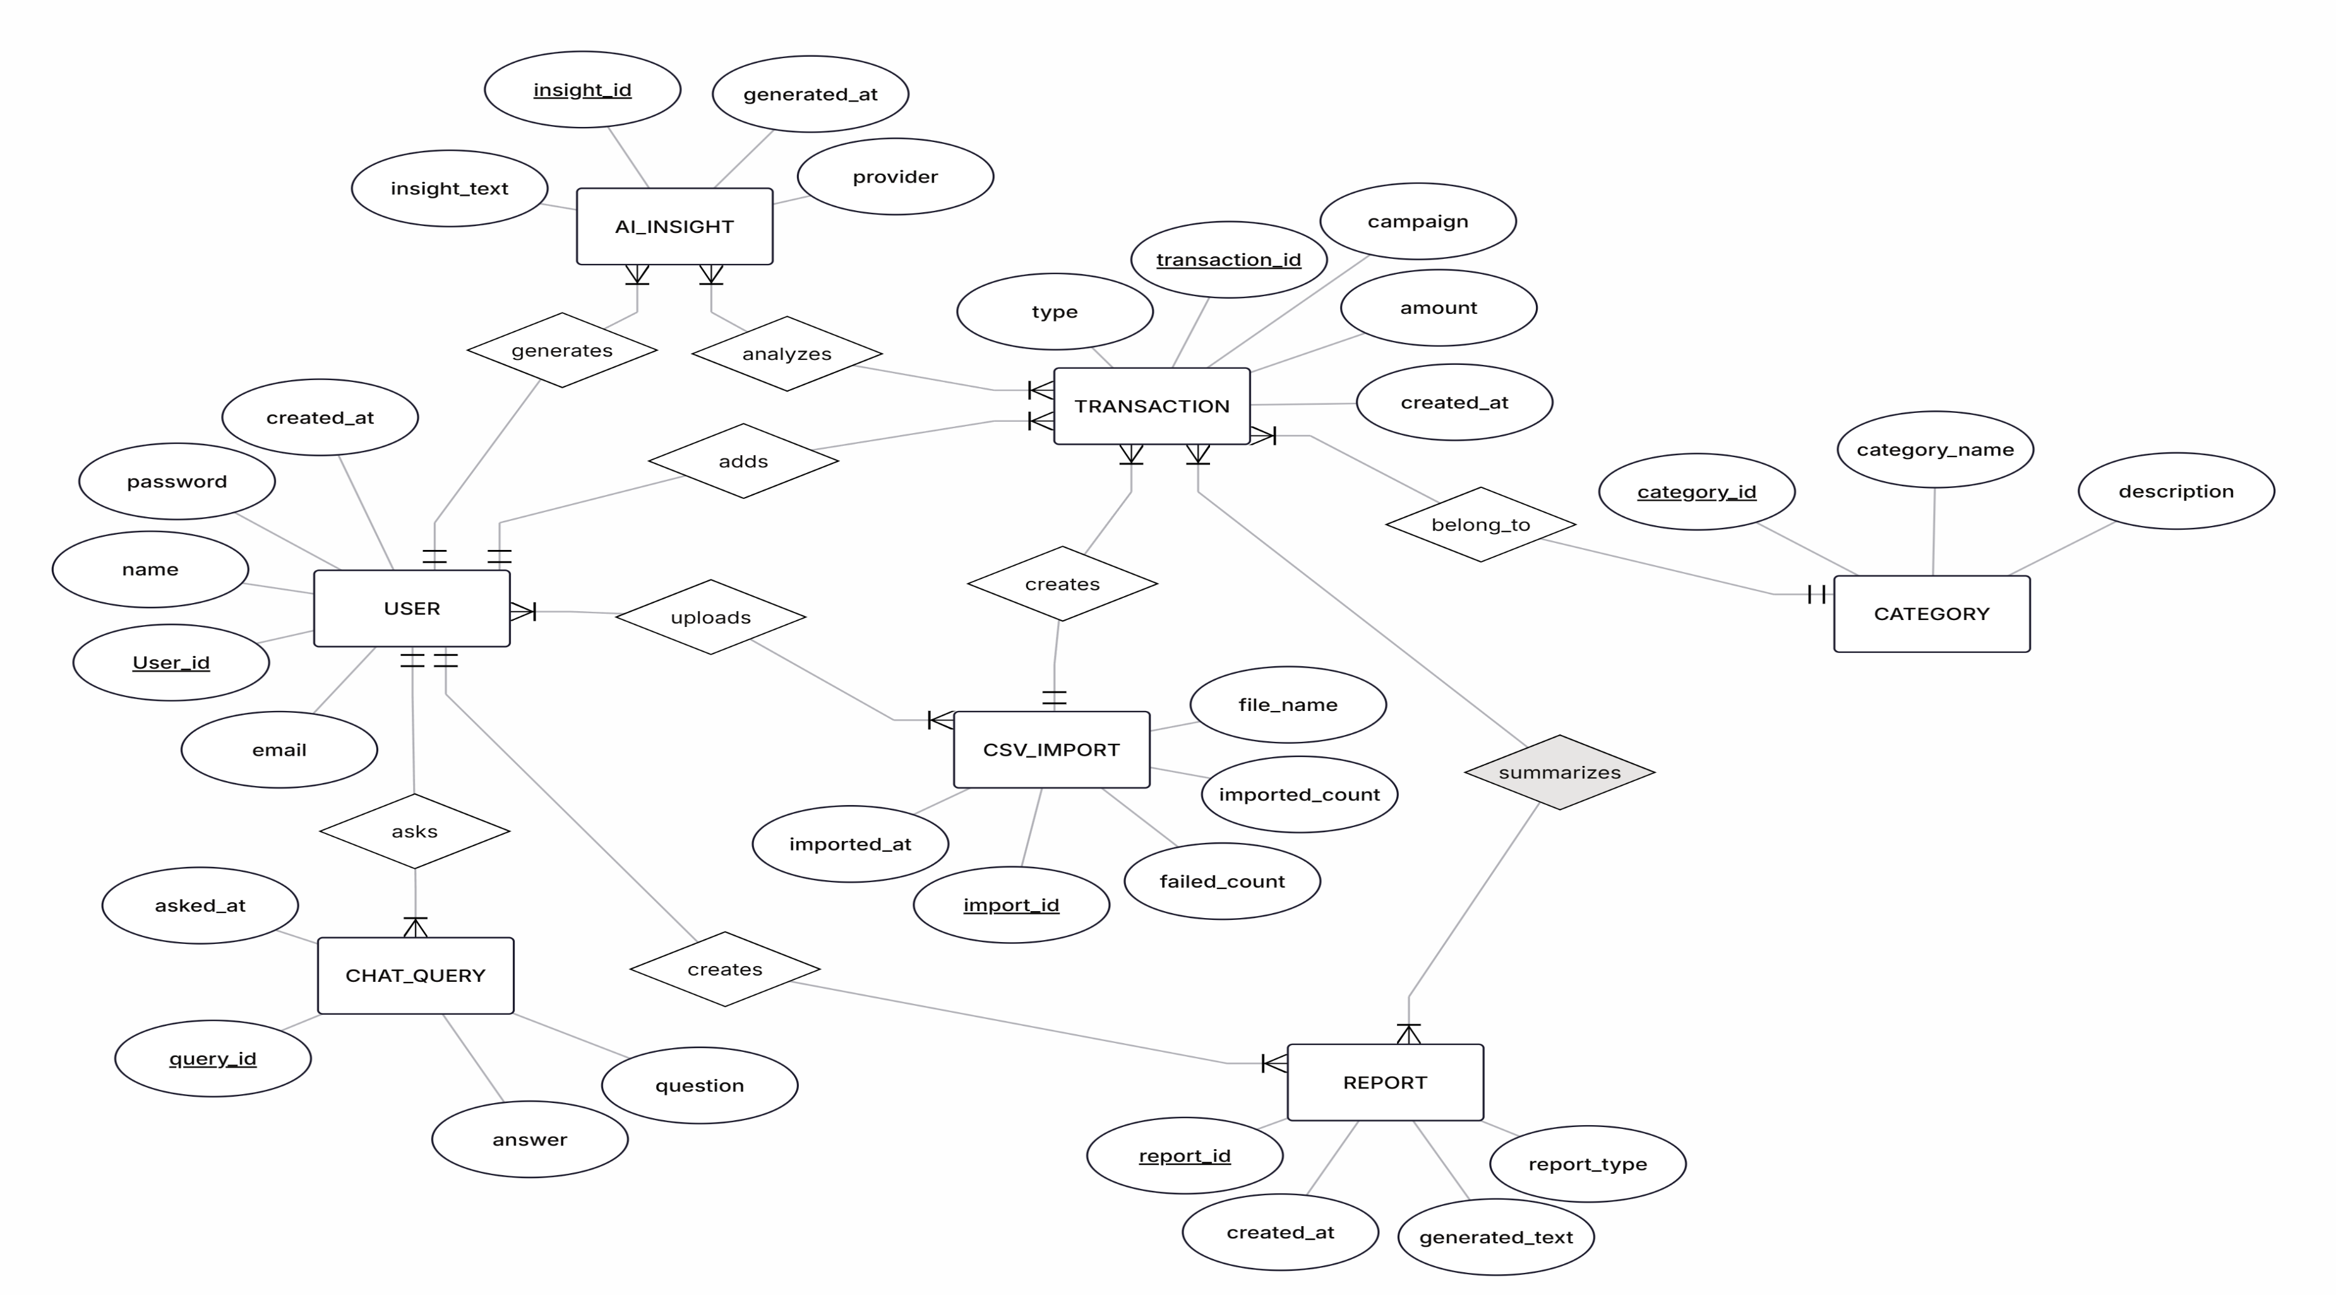
Entity-Relationship Diagram

Slide 5
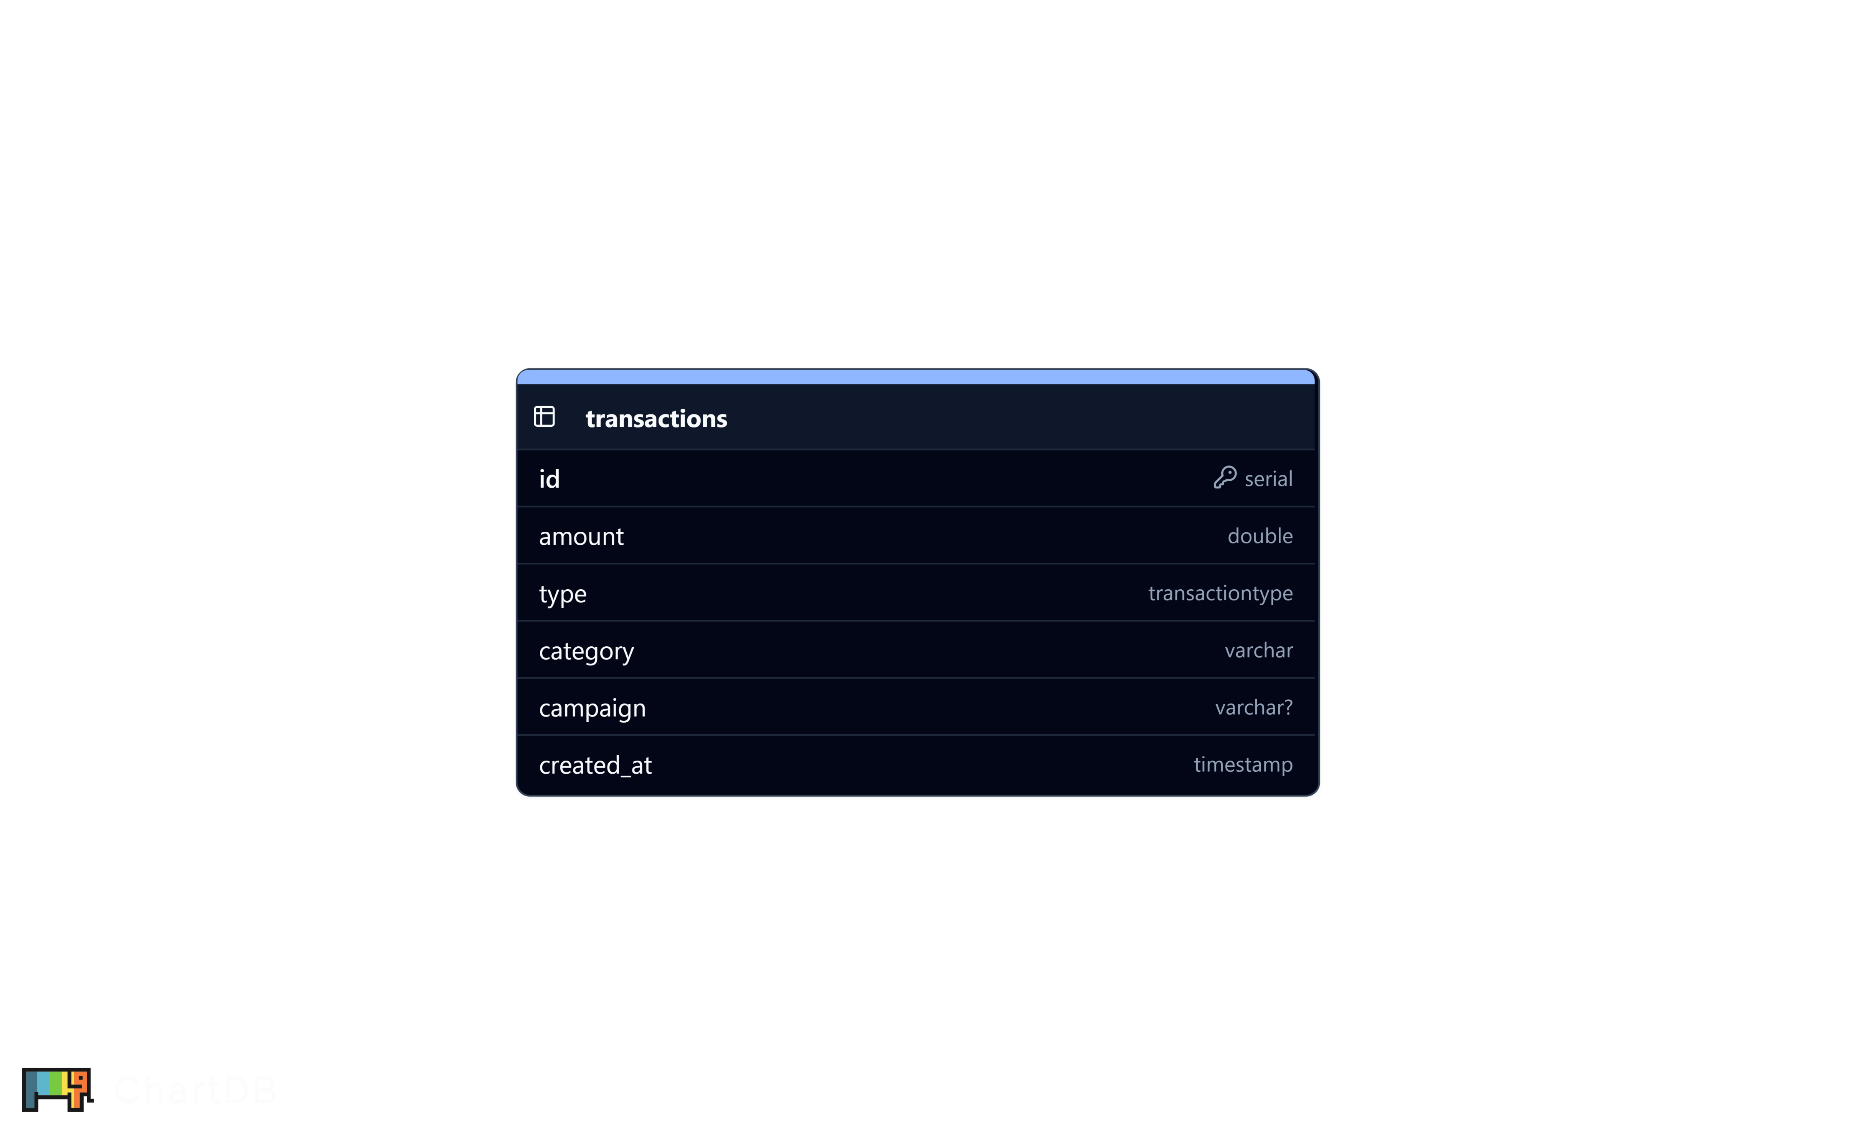
Database Schema Design

Slide 6
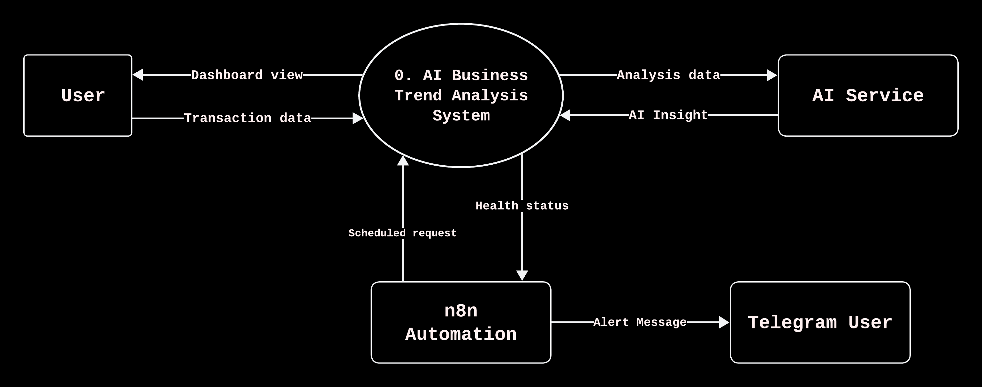
DFD Level 0

Slide 7
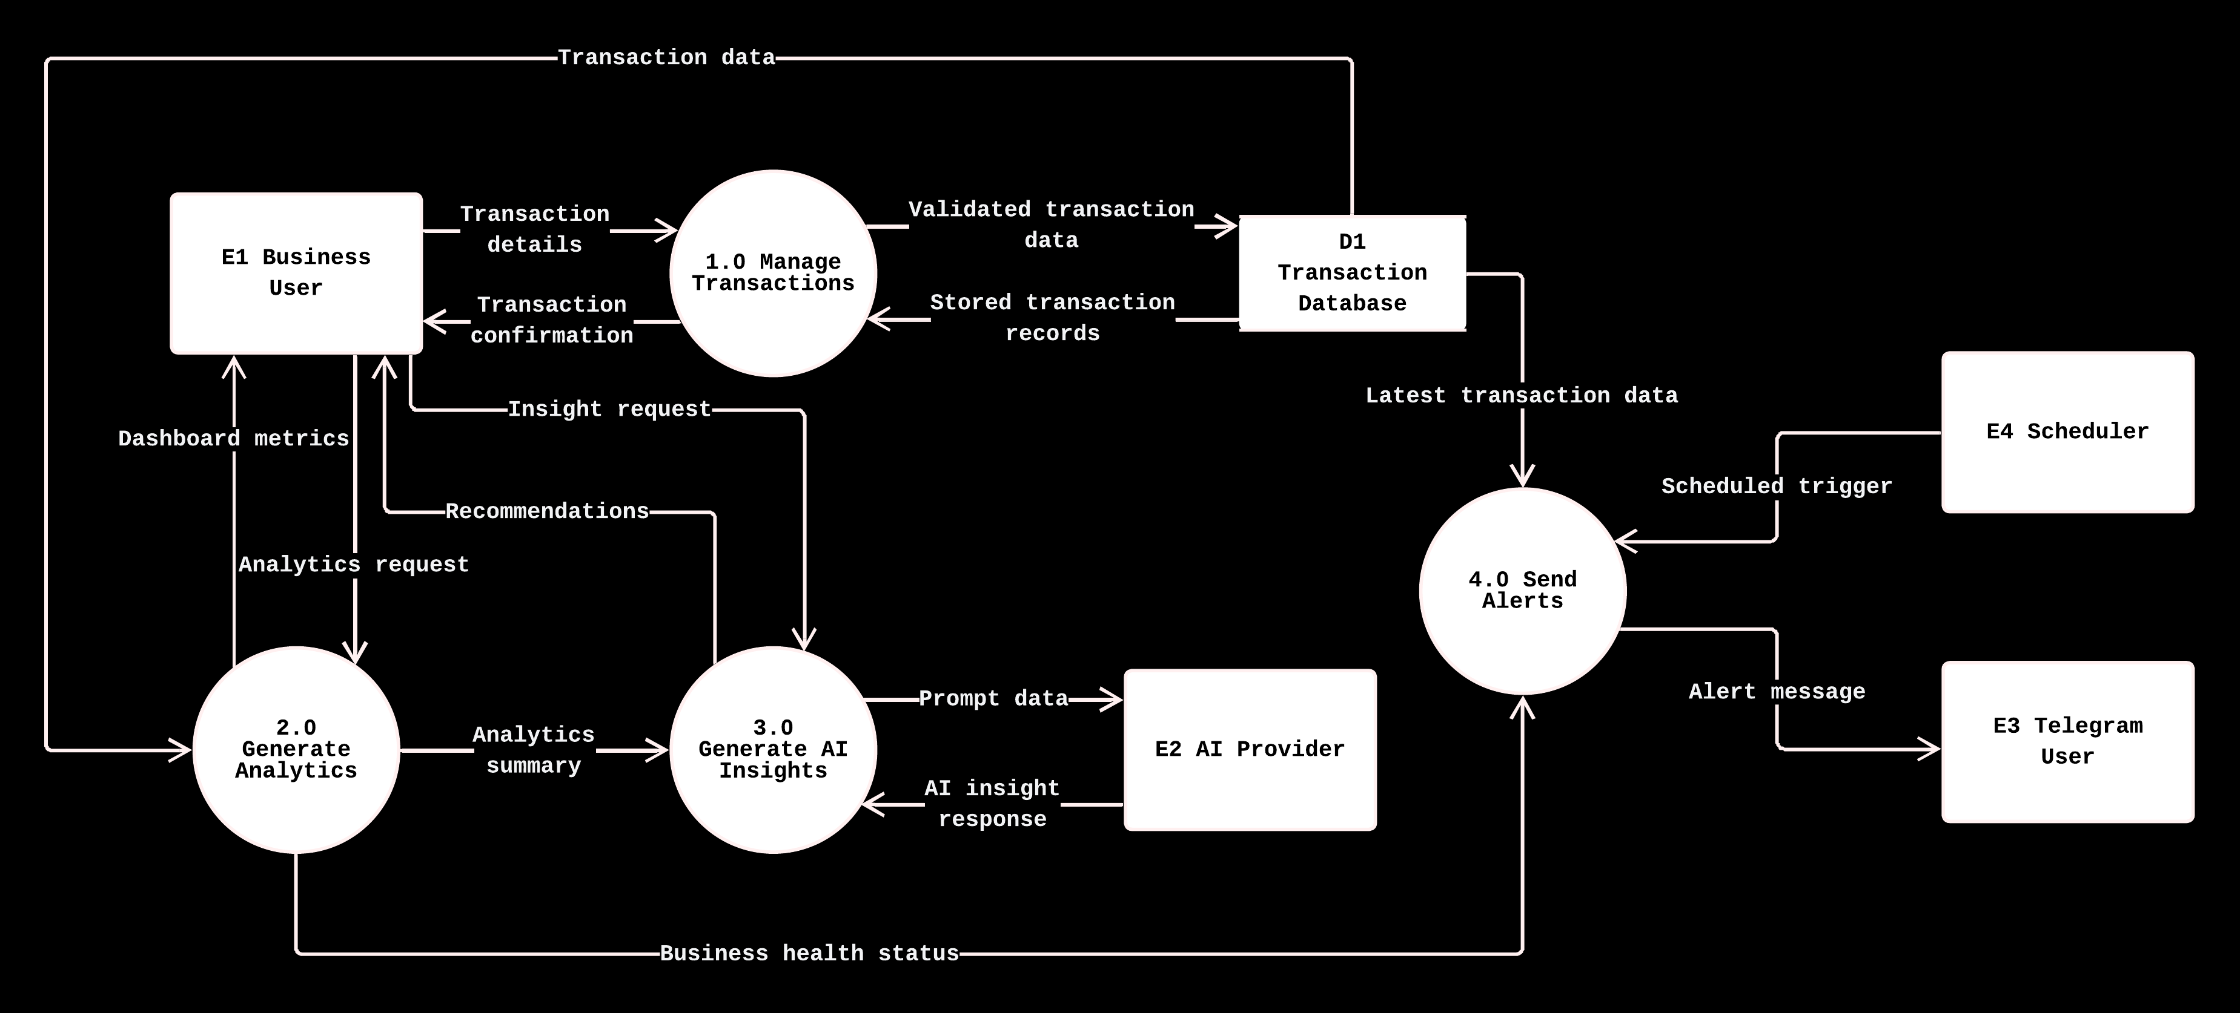
DFD Level 1

Slide 8
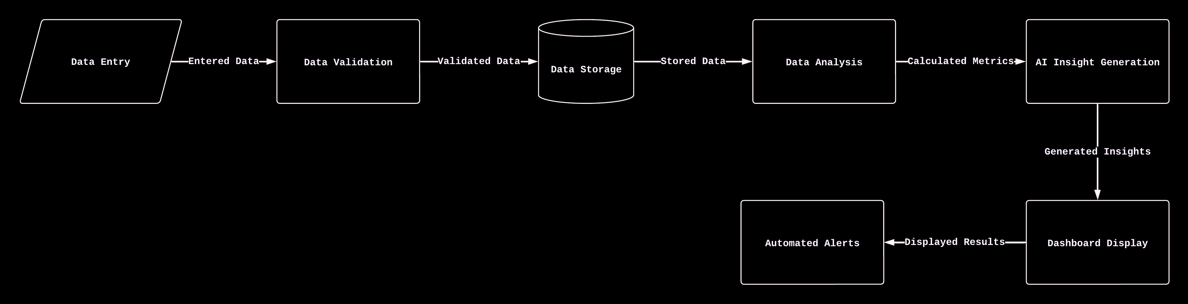
System Workflow & Methodology

Slide 9
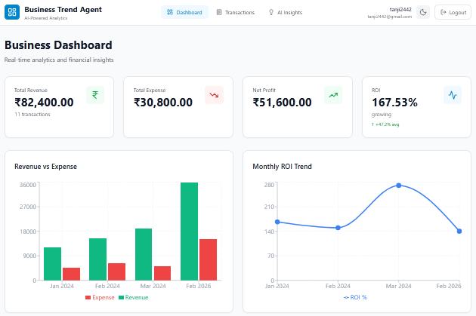
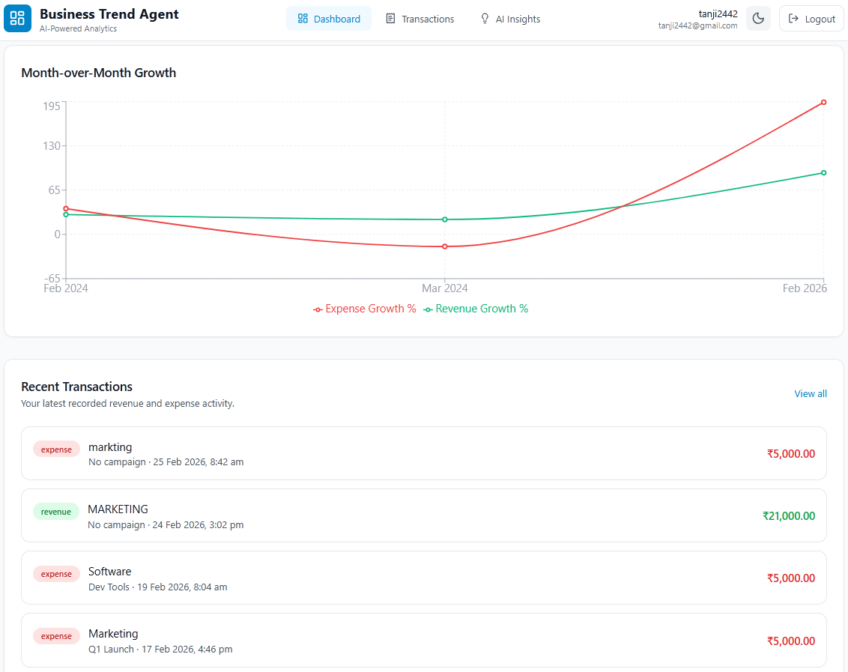
Form Design : Dashboard

Slide 10
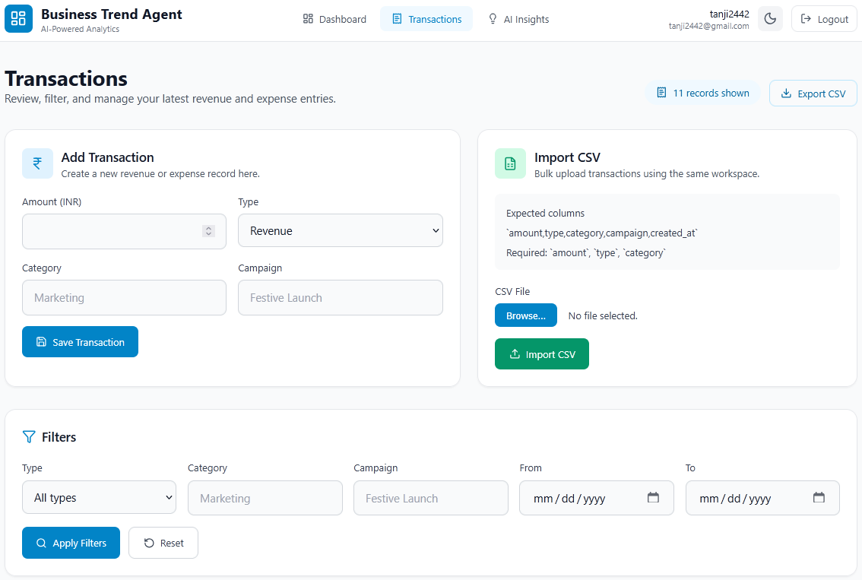
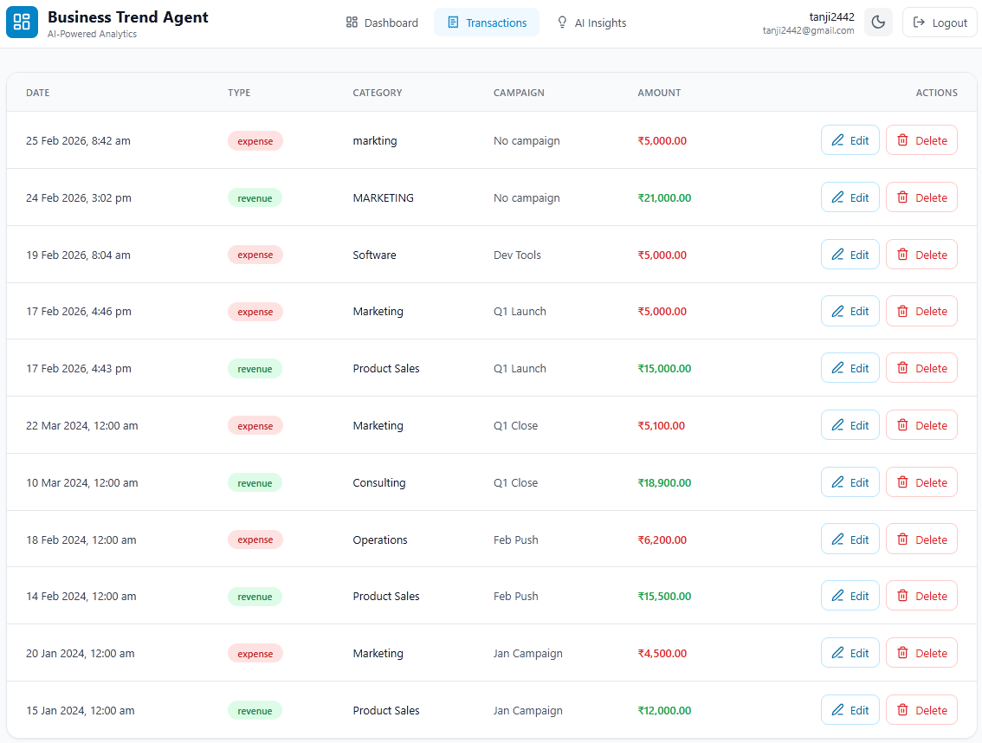
Form Design: Add Transaction

Slide 11
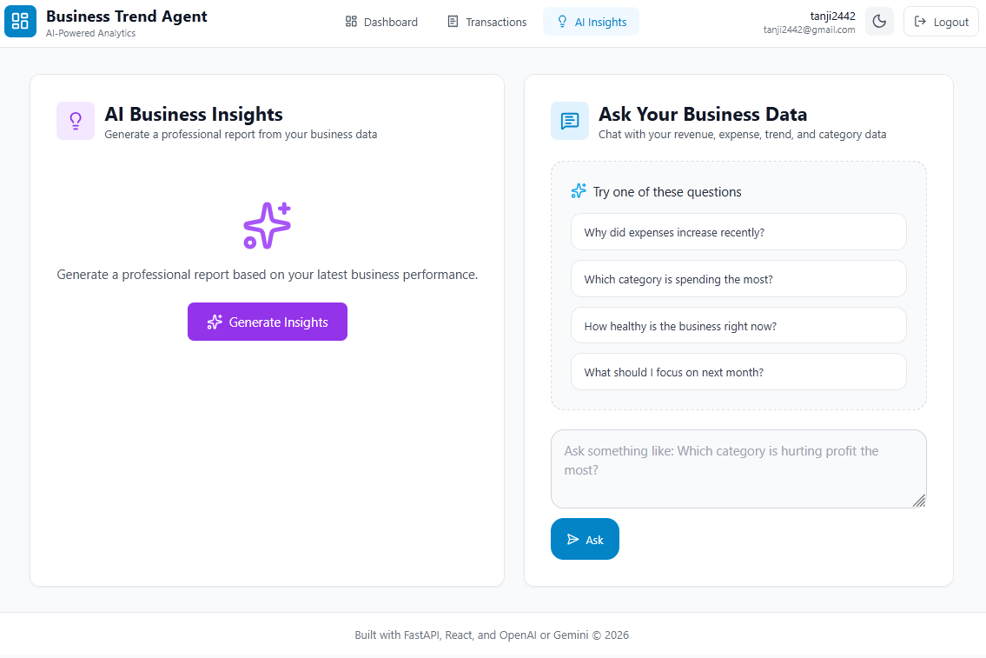
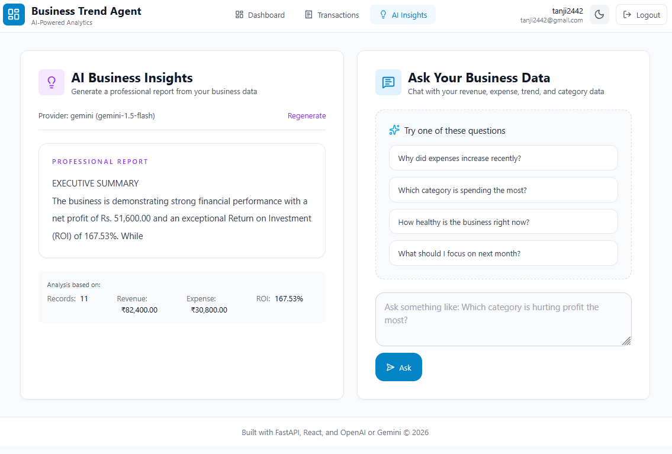
Form Design: AI-Insight

Slide 12
THANK YOU

